Slide 1
Webinar
From Firefighter to Strategic Planner
Matthew Clements-Wheeler
Download this presentation from: oego.co/SBMLeader

Slide 2
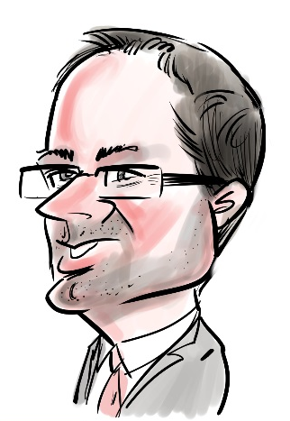
We are going to consider:
the difference between operational and strategic thinking
strategic planning approach for key areas such as succession planning, staffing, budgeting and facilities
key questions and analytical tools to use in the strategic planning process
ways to deal with potentially conflicting priorities and lead the decision-making process.
‘Whilst we can all get better at strategic planning, no-one ever really masters it’

Slide 3
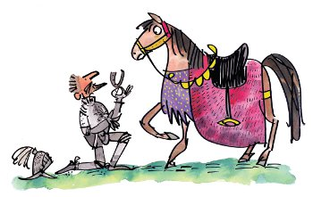
Understand the difference between operational and strategic thinking
For the want of a nail ...
The difference between the what and the how

Slide 4
The difference between operational and strategic thinking
Why
National Policy Priorities
School/Trust Goals
Department/Team Plans
Individual Activities
How

Slide 5
A word of warning: postcard or roadmap
‘There are pitfalls in both operational and strategic planning. Too much emphasis on the broad mission statement or vision and your plans don’t tell colleagues what to do. If you focus only on the operational, you can find yourself left behind, surprised by unexpected change or uncertain of where to go’

Slide 6
Strategic vs operational objectives
Strategic objectives are long-term organisational goals that help to convert a mission statement from a broad vision into more specific plans and projects. |  | Operational objectives are hourly, daily, weekly or monthly project benchmarks that implement larger strategic objectives.
They identify the major benchmarks for success and are designed to be measurable, specific and realistic. |  | As with strategic objectives, operational objectives also should be measurable and specific, though their focus is narrower.
They are translations of a mission statement that can be used by management to guide decision-making. |  | Operational objectives are set out with strategic objectives in mind and provide a means for management and staff to break down a larger strategic goal into workable tasks; their focus is narrower.
Strategic objectives are usually developed as a part of a two- to four-year plan that identifies key strengths and weaknesses and sets out the specific expectations that will allow a school or organisation to achieve its more broad-based mission or vision statement. |  | The most important difference between a strategic and an operational objective is its time frame; operational objectives are short-term goals.

Slide 7




Where do you spend your time?
‘Get me nice plants!’
Monday…n
Tuesday…n
Wednesday…n
Thursday…n
Friday…n
‘I can give you nice plants every day if you can wait just a little longer!’
Monday…n
Tuesday…n
Wednesday…n
Thursday…n
Friday…n

Slide 8
Elements
Vision
Where do we want to be?
How we plan to get there?
What actions will we take now?
How will we measure our progress each year?

Slide 9

It's not always about doing something new...
Which of your departments or teams perform best?
  Do you know why?
  Can this be replicated?

Slide 10

Key questions and analytical tools to use in the strategic planning process
Be analytic
Think Big Data
  Your school or trust is full of data:
  Water usage in toilets
  Canteen uptake figures
‘Pivot table’ your mindset
  Are you planning classroom refurb by age?
  Why not by poorest results?

Slide 11

Be curious
The power of the enquiring mind
The accidental discovery

Slide 12
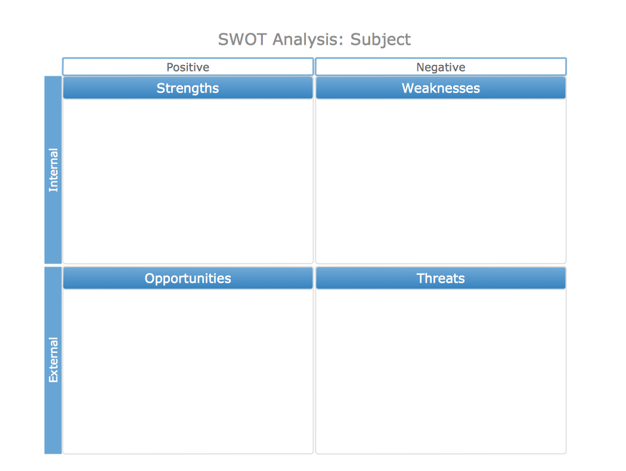
SWOT

Slide 13
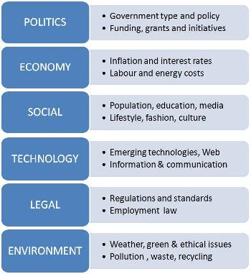
PESTLE

Slide 14
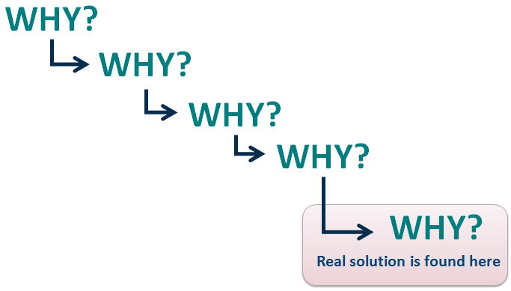
5 Whys

Slide 15
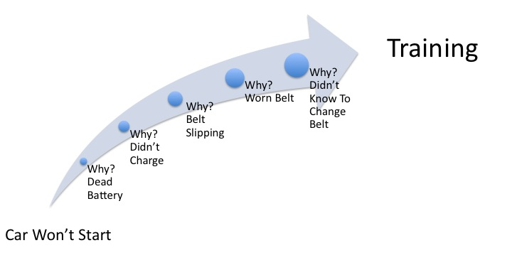
5 Why Analysis in Action

Slide 16
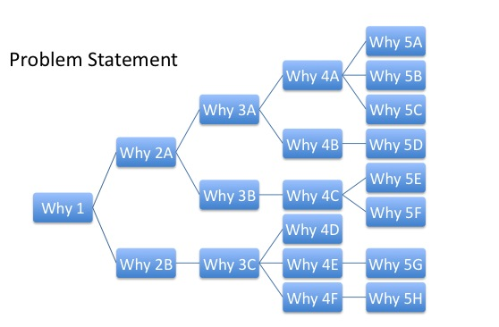
Keep digging!

Slide 17

Focus
Strategic = extroverted
Operational = introverted

Slide 18
Approach strategic planning for key areas
Identify the key variables.
Assemble relevant data.
Accept grey areas.
Consult!!!!!!
Must be affordable!
  but does it have to be sustainable?

Slide 19
Key variables
 | Succession planning | Staffing structure | Budgeting | Facilities
1.
2.
3.
4.
5.
6.
‘Do these variables help or hinder?’

Slide 20
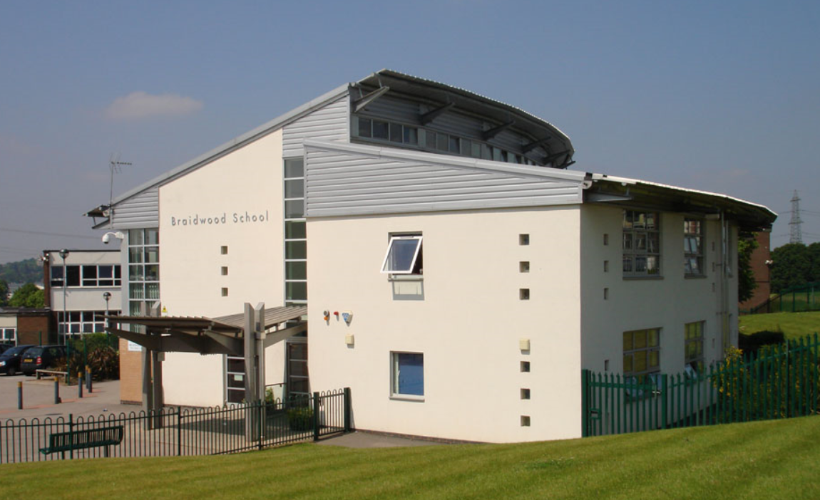
Look for ways to use current activities to facilitate strategic positioning
Braidwood School for the Deaf: steel frame includes lugs for future expansion.
BGGS T&L conference: we get delegates to bring their CVs.
Farandole French Primary on BGGS site.
First aid: train the trainer.

Slide 21
CPD around strategy
If an employer isn't doing enough to help develop these abilities, individuals, particularly those in or aspiring to senior ranks, must take it upon themselves to build their skills.
Forge new relationships; innovation requires different perspectives and new ideas. Strategic thinking is hard when you or your staff work in a silo, which reduces the supply of fresh input.
Perhaps put your hand up to lead a project team - your viewpoint and interactions with colleagues will enhance your business acumen and help you identify additional ways to support the school.
Strategic-thinking takes time to develop.
‘Strategic-thinking skills don’t appear overnight. In fact, they don’t develop after a single seminar, either!’

Slide 22
Resources available to you
Data
Business intelligence
Colleagues' info and experience
Pundits and commentators

Slide 23
Conflicts
‘But it’s for the good of the kids!’
‘I'm only interested in my department.’
You can't spin all the plates - decide which ones could be dropped without undue harm.
Your team's ability vs its ambition…
Time/Resources/Space.
Insurmountable conflict.

Slide 24
Improve your soft skills
Coming up with ideas is just one part of the equation. You'll need to be able to communicate them effectively and cultivate influence to secure buy-in.
You win some, you lose some - get over it!
Timing is everything.
Make sure you do today's jobs today.
Avoid analysis paralysis.

Slide 25
Take time to recharge
Periods of inactivity are essential not only for avoiding burnout, but for being more enterprising.
Strategic-thinking skills flourish during downtime, when the brain has a chance to decompress, wander, gain different perspectives and visualise different outcomes.
Don’t feel guilty about taking short breaks during the workday, making time for a real lunch and actually taking holidays.

Slide 26

Fire!
Common problem in schools is that strategic leaders get pulled back into operational firefighting:
  turn on voicemail
  turn off email notifications
  work from home or at least from a different desk
  plan your day; put the tasks you want to complete on your calendar
  involve your team.

Slide 27

Efficiencies in Schools conference
Learn how to manage the ‘recruitment crisis’ and attract high-quality candidates.
Gain expert insight on how to identify, nurture and retain talent through effective CPD routes.
Practical guidance on managing short and long term staff absence robustly and fairly.
Learn how to strategically look at your staffing structure and create a restructures plan.
22nd November, London
Details and register at: my.optimus-education.com/conferences/efficiency

Slide 28
Find more resources at:
my.optimus-education.com/knowledge-centre/school-business-management
Follow us on Twitter:
@OptimusEd
@BusinessOE
Questions & Answers

