Slide 1
Webinar
Understanding and motivating your colleagues
Russell Dalton

Slide 2
What is emotional intelligence – and why does it matter?
Learning objectives
Understand the personal and professional benefits of emotional intelligence (or EQ).
Increase awareness of ‘personality types’ and how responding differently to different types can improve performance and relationships within a team.
Become more self-aware as to your own preferred behaviours and styles and how that may influence others.
Be better equipped to perform under pressure and get results from your colleagues and team.

Slide 3
What is emotional intelligence – and why does it matter?
“The capacity for recognising our own feelings and those of others for motivating ourselves, and for managing emotions well in ourselves and in our relationships”.
Daniel Goleman
Notes:
The term, popularised by Daniel Goleman a Harvard-educated PhD in Psychology in his best seller book Emotional Intelligence.
Goleman defines Emotional Intelligence as “the capacity for recognising our own feelings and those of others for motivating ourselves, and for managing emotions well in ourselves and in our relationships”.
Did you ever think back on some of the important decisions you made in your life and wonder “What was I thinking?” or “Did I really do that and why?” Not using your emotional intelligence may be to blame for those bad decisions and actions.
Emotional Intelligence (EQ) is the ability to identify, use, understand, and manage emotions in an effective and positive way. A high EQ helps individuals to communicate better, reduce their anxiety and stress, defuse conflicts, improve relationships, empathise with others, and effectively overcome life’s challenges.
Our emotional intelligence affects the quality of our lives because it influences our behaviour and relationships. EQ is synonymous with self-awareness because it enables us to live our lives with intention, purpose, and autonomy.
Many of us move through life making important decisions based on our current circumstances. We may perceive them as being beyond our ability to change, thus limiting our options and solutions. Taking time to reflect and examining why we decide to do what we do enables us to lead lives determined by our conscious intentions rather than circumstances alone.
Developing EQ can greatly influence our success. Our personal situations and intelligence are factors as well; however, EQ can profoundly affect our choices by creating options we may not have otherwise imagined or considered to be possibilities.

Slide 4
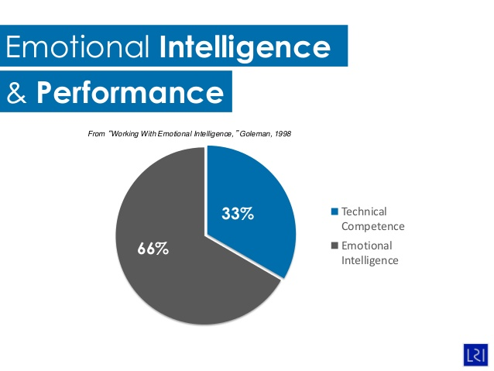
What is emotional intelligence – and why does it matter?
Out of 20,000+ employees over a 3 year period. Of those who fail:
26% fail because they can’t learn from feedback
23% fail because they cannot understand and manage emotions
11% fail because they lack key technical skills
Havard Business Review 2002
Notes:
But how is this concept important for managers and growing businesses?
Firstly, emotional intelligence is directly linked to performance. Goleman sites that one third of performance is technical competence, whilst the other two thirds is emotional intelligence.
This is further backed up by a 2002 Havard Business School study:
Out of 20,000+ employees over a 3 year period. Of those who fail:
26% fail because they can’t learn from feedback
23% fail because they cannot understand and manage emotions
11% fail because they lack key technical skills
Effective management of organisations and human resources is facing enormous challenges today. Organisations are downsizing and restructuring to compete to stay alive. People are nervous and sceptical to trust each other. Today more than ever, getting closer to your employees could be the real key to differentiate your school and achieve long-term success.
Some of the most important aspects of emotional intelligence for leaders to make effective decisions are: self-awareness, self-confidence, self-control, commitment and integrity, and the ability to listen, communicate, influence and accept change.
Managers who do not develop emotional intelligence have difficulty in building good relationships with peers, subordinates, superiors and clients. (Goleman).
Remember: Finding, recruiting, training, retaining leaders and bringing in new people with high emotional intelligence is key for a healthy and stable growth of your school.

Slide 5
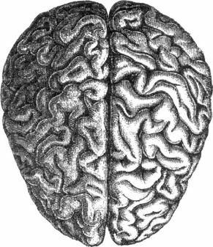
What is emotional intelligence – and why does it matter?
Self -awareness
Emotional awareness
Self-confidence
Accurate self-assessment
Personal
Self -regulation
Motivation
Self-control
Trustworthiness
Conscientiousness
Adaptability
Innovation
Achievement drive
Commitment
Initiative
Optimism
Influence
Communication
Conflict management
Leadership
Change catalyst
Building bonds
Collaboration and cooperation
Team capabilities
Emotional
Intelligence
Social skills
Empathy
Understanding others
Developing others
Service orientation
Leveraging diversity
Political awareness
Social
Notes:
Personal Skills or Competences - How we manage ourselves
Self-awareness. (Emotional awareness, Accurate self-assessment, Self-confidence)
Self-awareness is the skill of being aware of and understanding your emotions as they occur and as they evolve. It is wrong to think of emotions as either positive or negative. Instead, you should think of them as appropriate or inappropriate.
For example, anger is usually associated with being a negative emotion. However, it can be a completely reasonable and appropriate emotion in certain circumstances – emotional intelligence allows us to recognise our anger and understand why this emotion has occurred.
Effective self-assessment of feelings and emotions will help to improve your confidence and self-esteem.
Self-regulation. (Self-control, Trustworthiness, Conscientiousness, Adaptability, Innovation)
Having learned to be aware of your emotions, the skill of self-regulation relates to managing them appropriately and proportionately.
Self-management skills relate to the emotions you are feeling at any given time or in any given circumstance and how well you manage them. Self-control is a fundamental part of this, but other aspects relate to what you then do: whether you behave in a way which is recognised as ‘good’ or ‘virtuous’ or not.
Motivation. (Achievement drive, Commitment, Initiative, Optimism)
Self-motivation includes our personal drive to improve and achieve, commitment to our goals, initiative, or readiness to act on opportunities, and optimism and resilience.
Self-motivation and personal time management are key skills in this area. Do not make unreasonable demands on yourself, learn to be assertive rather than just saying, ‘Yes’ to the demands of others.
Social Skills or Competences - How we handle relationships with others
Empathy. (Understanding others, Developing others, Service orientation, Leveraging diversity, Political awareness)
Empathy is an awareness of the needs and feelings of others both individually and in groups, and being able to see things from the point of view of others.
Empathy helps us to develop a stronger understanding of other people’s situations.
It includes understanding others, developing others, having a service orientation, leveraging diversity, and political awareness.
Empathy can often be difficult to achieve. Learn to listen effectively to both the verbal and non-verbal messages of others, including body movements, gestures and physical signs of emotion. Use questions to find out more about other people and what they are feeling, and feedback to clarify that you have correctly understood their feelings. Acknowledge and respect the feelings of others even if you disagree, and avoid making comments or statements that are judgemental, belittling, rejecting or undermining.
Social skills. (Influence, Communication, Conflict management, Leadership, Change catalyst, Building bonds, Collaboration and cooperation, Team capabilities)
Social skills encompasses a wide range of relationship and interpersonal skills. These range from leadership through to influencing and persuading, and managing conflict, as well as working in a team.
The term ‘social skills’ covers a wide variety of skills and competencies, many of which are rooted in self-esteem and personal confidence. By developing your social skills, being easy to talk to, being a good listener, being sharing and trustworthy, you also become more charismatic and attractive to others.
This in turn improves self-esteem and confidence which makes it easier for positive personal dialogue and a greater understanding and acceptance of your own emotions.

Slide 6
Behavioural styles
Analytical — This behavioural style is noted for the ability to gather and review data. This style is typical of people in technical positions such as engineering, accounting and IT. Details and accuracy are important to these people, and they take great pride in providing information that is correct.
Amiable — Amiables are highly supportive individuals interested in establishing and maintaining relationships in an organisation. This behavioural style is typical of employees in human resources and social or medical services.
Driver — Drivers, as the name implies, are often the driving force behind getting things done in an organisation. They are results-oriented individuals who are motivated by goals. Drivers typically gravitate to positions in management.
Expressive — Expressives are visionaries, good at grasping the big picture. Expressives typically gravitate to positions in marketing and strive to get ahead in an organisation. They are truly the ‘politicians’ in an organisation, establishing and using contacts extensively.
Notes:
Skills: Analyticals are persistent and don’t mind spending extra time to make sure things are right. For the most part, they are orderly and present ideas or solutions in an orderly manner.
Caution: Due to their desire for accuracy and attention to detail, analyticals can come across as indecisive. They can also be critical of solutions that veer from what the “facts” say. They have little use for gut feelings and may go to great lengths to avoid dealing with those who do.
Favorite word: Why?
Best Performance: Allow them sufficient time to gather and interpret information.
Skills: Amiables are great at achieving consensus within an organization. They can effectively facilitate groups and bring sides together to develop a win/win solution.
Caution: Sometimes an amiable person’s desire to reach agreement may cause the person to conform too easily, intent in maintaining relationships rather than reaching the best solution.
Favorite word: We.
Best Performance: Encourage amiables to initiate and stand behind their ideas. Allow them to maintain relationships in the organization
Skills: Drivers are effective at time management, seeming to possess an innate ability to devote just the right amount of time and effort to things that need to be done. Drivers rarely struggle with making decisions.
Caution: Because they are so driven for success in a timely manner, drivers may neglect the impact that their actions have on others. They may be viewed as willing to do almost anything to get the job done.
Favorite word: When?
Best Performance: Give them options and probabilities, allowing them to formulate their own decisions whenever possible.
Skills: If you need to develop new concepts, then enlist the help of an expressive. Their ability to size up a situation based on personal experience can assist them in finding creative solutions, perhaps never considered by others.
Caution: Being so confident of their “gut feelings,” they may often ignore or neglect facts that are presented to them. Their lack of attention to detail can be an obstacle.
Favorite word: I.
Best Performance: Show interest in their ideas and compliment them, even if you are not sure they are totally deserving of such praise.
There is no one best behavioral style, and it is not your personal style that is important. What is important is recognizing the behavioral style of others so that you can deal with them effectively.

Slide 7
Where is your energy naturally directed?
Extraverts often:
•have high energy
•talk more than listen
•think out loud
•act, then think
•like to be around people a lot
•prefer a public role
•can sometimes be easily distracted
•prefer to do lots of things at once
•are outgoing & enthusiastic.
Introverts often:
•have quiet energy
•listen more than talk
•think quietly inside their heads
•think, then act
•feel comfortable being alone
•prefer to work "behind-the-scenes"
•have good powers of concentration
•prefer to focus on one thing at a time
•are self-contained and reserved.
Notes:
Extraverts' energy is directed primarily outward, towards people and things outside of themselves. Introverts' energy is primarily directed inward, towards their own thoughts, perceptions, and reactions. Therefore, Extraverts tend to be more naturally active, expressive, social, and interested in many things, whereas Introverts tend to be more reserved, private, cautious, and interested in fewer interactions, but with greater depth and focus.

Slide 8
What kind of information do you naturally notice and remember?
Sensors often:
•focus on details & specifics
•admire practical solutions
•notice details & remember facts
•are pragmatic - see what is
•live in the here-and-now
•trust actual experience
•like to use established skills
•like step-by-step instructions
•work at a steady pace.
Intuitives often:
•Focus on the big picture & possibilities
•admire creative ideas
•notice anything new or different
•are inventive - see what could be
•think about future implications
•trust their gut instincts
•prefer to learn new skills
•like to figure things out for themselves
•work in bursts of energy.
Notes:
Sensors notice the facts, details, and realities of the world around them whereas Intuitives are more interested in connections and relationships between facts as well as the meaning, or possibilities of the information. Sensors tend to be practical and literal people, who trust past experience and often have good common sense. Intuitives tend to be imaginative, theoretical people who trust their hunches and pride themselves on their creativity

Slide 9
How do you decide or come to conclusions?
Thinkers often:
•make decisions objectively
•appear cool and reserved
•are most convinced by rational arguments
•are honest and direct
•value honesty and fairness
•take few things personally
•are good at seeing flaws
•are motivated by achievement
•argue or debate issues for fun.
Feelers often:
•decide based on their values & feelings
•appear warm and friendly
•are most convinced by how they feel
•are diplomatic and tactful
•value harmony and compassion
•take many things personally
•are quick to compliment others
•are motivated by appreciation
•avoid arguments and conflicts.
Notes:
Thinkers make decisions based primarily on objective and impersonal criteria--what makes the most sense and what is logical. Feelers make decisions based primarily on their personal values and how they feel about the choices. So, Thinkers tend to be cool, analytical, and are convinced by logical reasoning. Feelers tend to be sensitive, empathetic, and are compelled by extenuating circumstances and a constant search for harmony

Slide 10
What kind of environment makes you the most comfortable?
Judgers often:
•like to have things settled
•take responsibilities seriously
•pay attention to time & are usually prompt
•prefer to finish projects
•work first, play later
•seek closure
•see the need for most rules
•like to make & stick with plans
•find comfort in schedules.
Perceivers often:
•like to keep their options open
•are playful and casual
•are less aware of time and may run late
•prefer to start projects
•play first, work later
•may have difficulty making some decisions
•question the need for many rules
•like to keep plans flexible
•want the freedom to be spontaneous.
Notes:
Judgers prefer a structured, ordered, and fairly predictable environment, where they can make decisions and have things settled. Perceivers prefer to experience as much of the world as possible, so they like to keep their options open and are most comfortable adapting. So, Judgers tend to be organised and productive while Perceivers tend to be flexible, curious, and nonconforming.

Slide 11
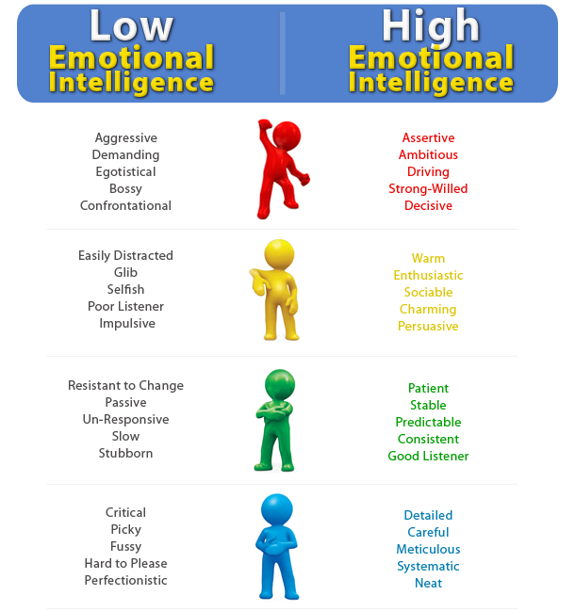

Slide 12
In summary
Working on your emotional intelligence could well be the most important aspect of your personal development.
Research has shown that people with higher levels of emotional intelligence enjoy more satisfying and successful careers and relationships. If you think about ways to enhance your EI, you are likely to become more interesting and attractive to others, and you will also give your self-esteem a boost.
Notes:
In Summary
Working on your emotional intelligence could well be the most important aspect of your personal development.
Research has shown that people with higher levels of emotional intelligence enjoy more satisfying and successful careers and relationships. If you think about ways to enhance your EI, you are likely to become more interesting and attractive to others, and you will also give your self-esteem a boost.

Slide 13
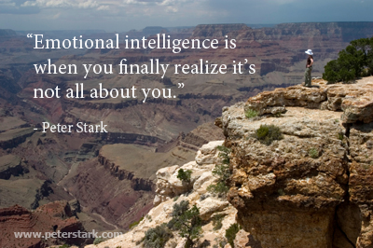

Slide 14
Find more resources at:
http://my.optimus-education.com/knowledge-centre/school-business-management
Follow us on Twitter: @BusinessOE
Questions & Answers

