Slide 1
Webinar
Courageous conversations for improving performance
‘But I don’t feel very brave!’
Nickii Messer

Slide 2
Practical ideas and advice for:
Understanding the need for improved performance
Becoming more confident in addressing underperformance
Improved understanding of how people respond to performance conversations
Developing strategies for initiating and managing difficult conversations

Slide 3
The need for improved performance

Slide 4
Being courageous is...
Less about this...
And more about this...

Slide 5
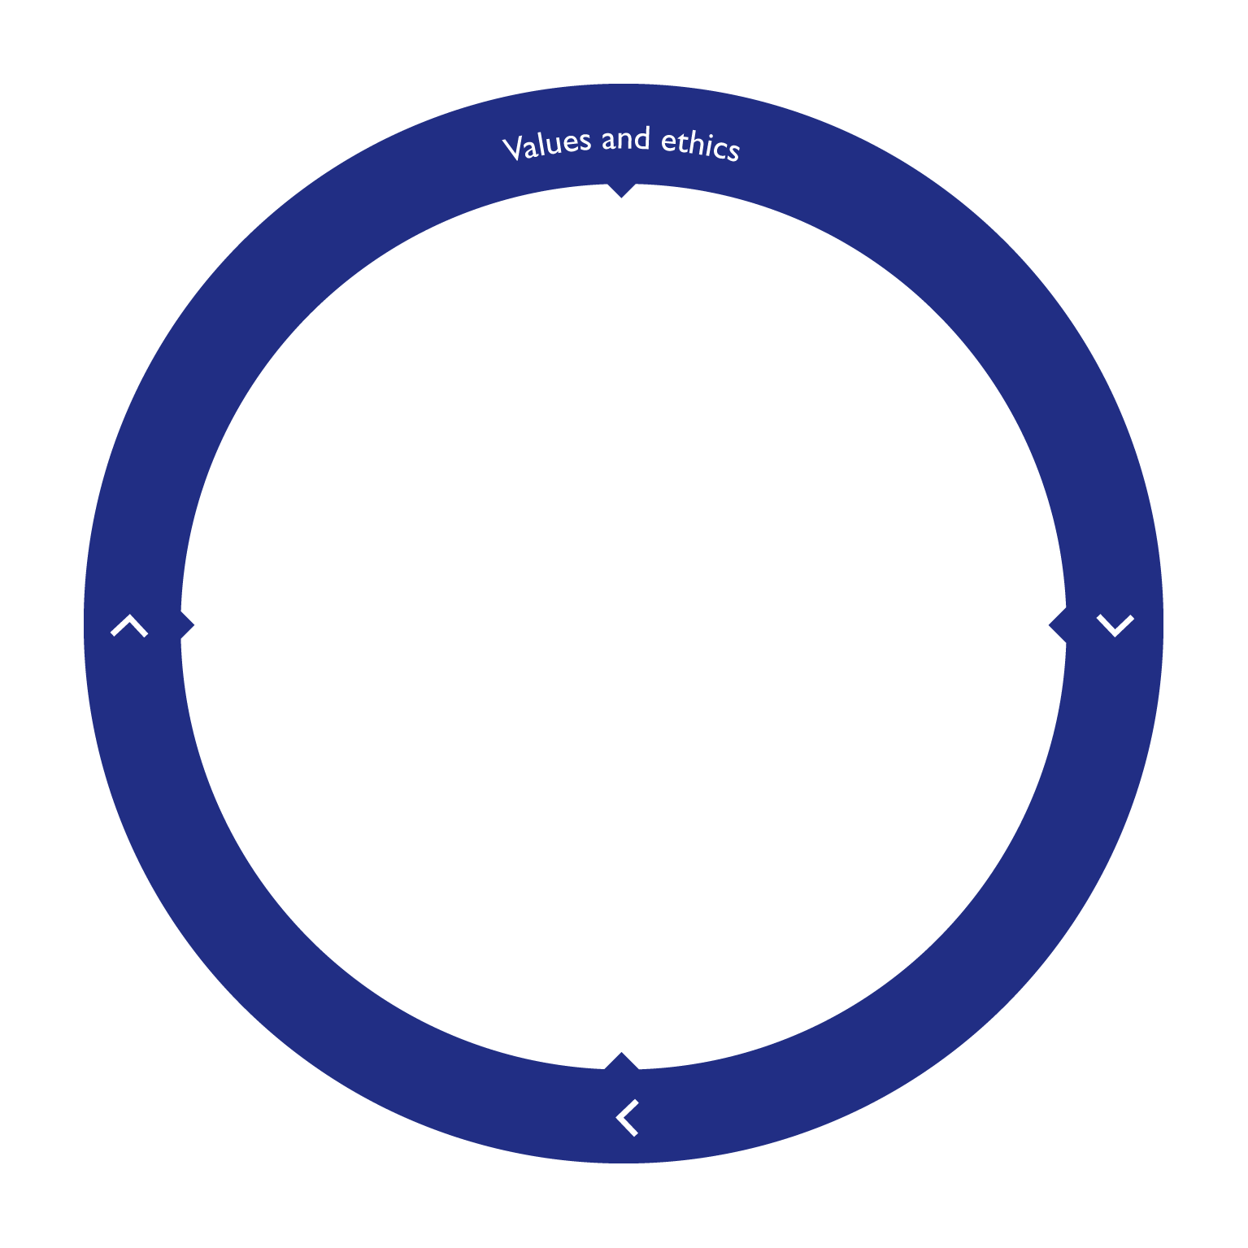
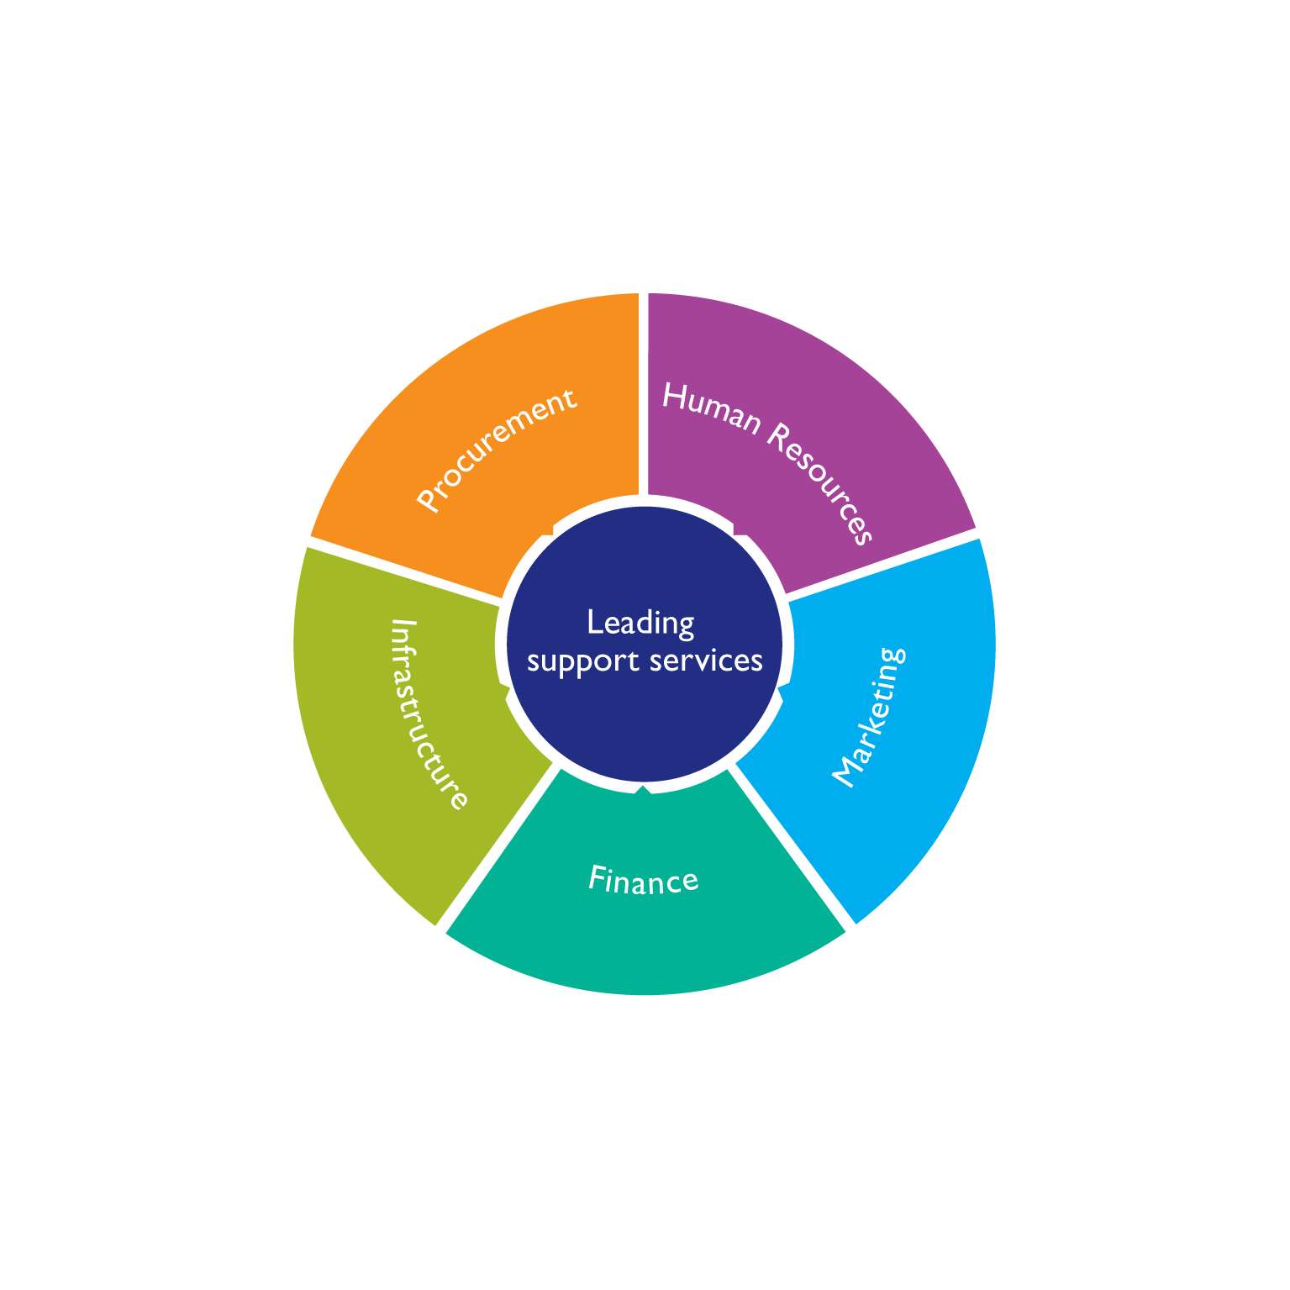
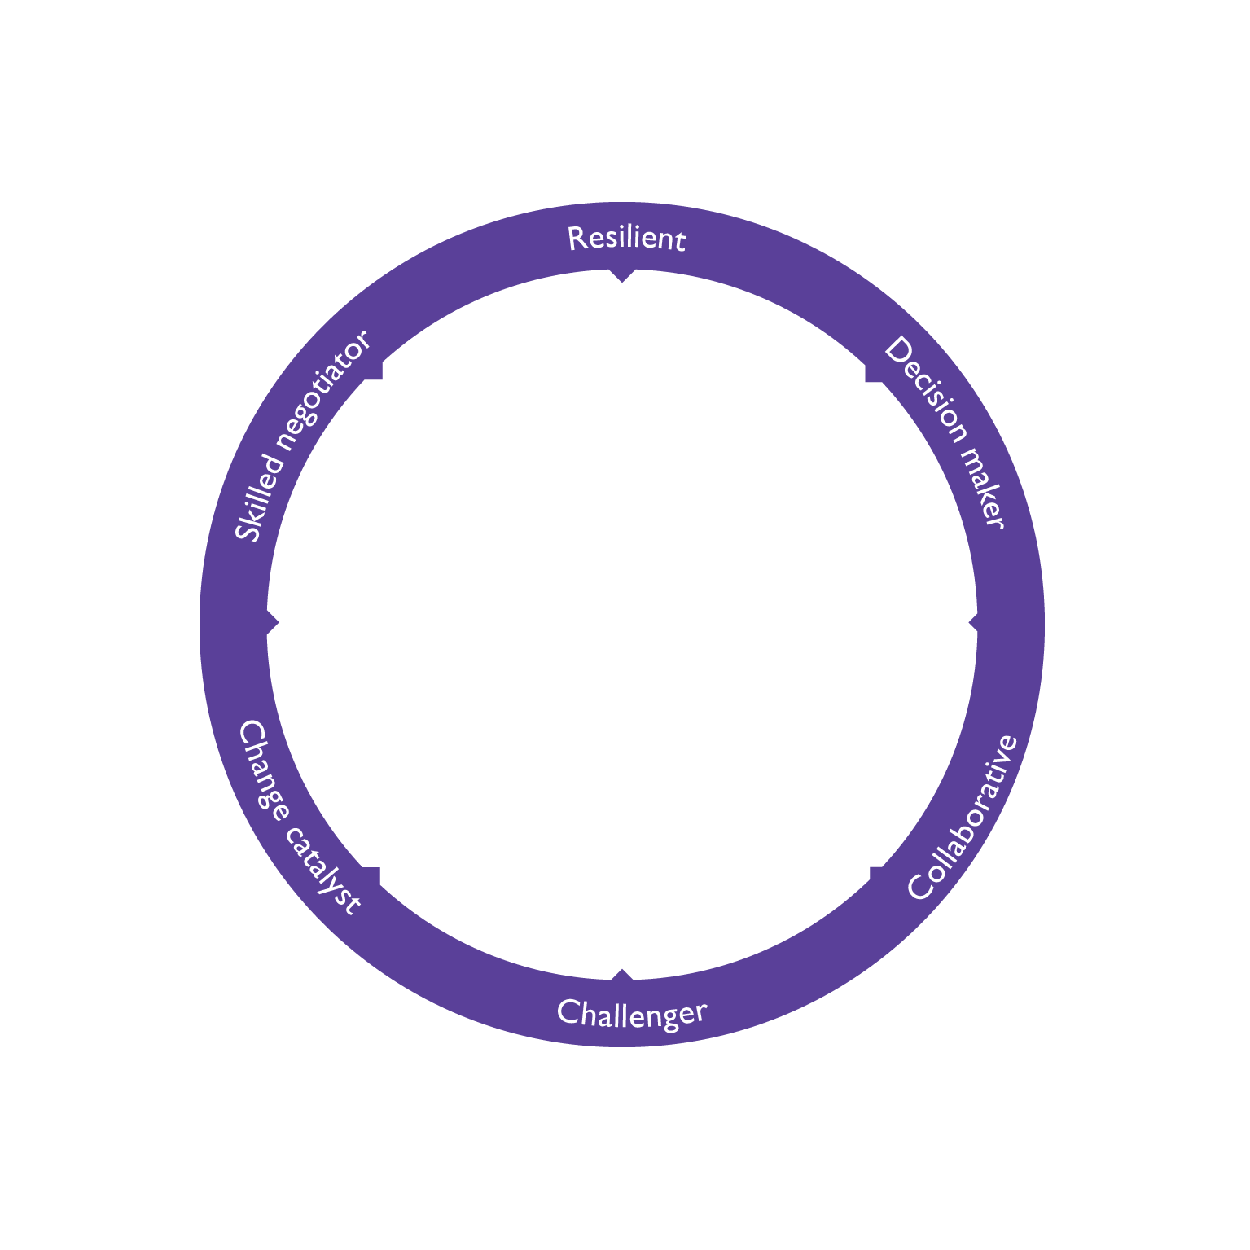
NASBM Professional Standards
NASBM Code of ethics
In all activities, school business management professionals should... make the wellbeing and improvement of the life chances of pupils a basic principle in all decision-making and actions.
NASBM (2015)

Slide 6
NASBM Professional Standards
LEADING SUPPORT SERVICES
Tier 3
Fosters and facilitates the development potential in others. Identifies and takes steps to deal with obstacles in a fair and equitable manner
NASBM (2015)

Slide 7
So, that’s why. Let’s look at how...

Slide 8
Process
Organisational values and improvement plan
Dissemination of key information – the ‘conversation’
Performance management and training

Slide 9
Performance management
Good performance management helps everyone in the organisation to know:
what the business is trying to achieve
their role in helping the business achieve its goals
the skills and competencies they need to fulfil their role
the standards of performance required
how they can develop their performance and contribute to the development of the organisation
how they are doing
when there are performance problems and what to do about them.
ACAS (2016)

Slide 10
Difficult conversations
Regular reviews and support will help minimise under-performance. Nevertheless there may be occasions when, despite adequate support, an employee’s performance consistently fails to reach the required standard.
Where this is the case managers must not duck the issue.
ACAS (2014)

Slide 11
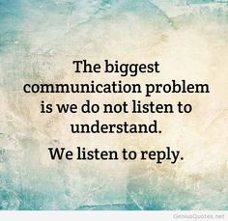
Difficult conversations
Performance management framework in place – and followed!
PM used as a process, not an event
Check other policies are in place (e.g. capability)
Make sure you are the right person to have the conversation
Why is it ‘difficult’ – is it just your fear?
Have planned conversations – right time, right place
Be aware – deal with the root cause (five whys)
Explain the problem – facts, evidence
Explain what is at stake
Listen to understand
Know outcome required - ‘bottom line’
Have a plan of action, but be flexible

Slide 12
Negative reactions
‘When dealing with people, remember you are not dealing with creatures of logic, but creatures of emotion’ Dale Carnegie
Incorrect facts
Incorrect root cause
Instinctive reaction
Win-lose
Guilty
Feeling accused, picked on
Fear – especially lack of skills
Not dealt with in time
Surprises
Unfair process
Lack of trust
In denial

Slide 13
Win win

Slide 14
Next steps
Agree plan
Confirm key points in writing
Follow up meeting(s)
Do what you promised
Keep following the policies
Keep it professional
WWW, EBI
Keep policies reviewed and updated

Slide 15
Starting point

Slide 16
Find more resources at:
my.optimus-education.com/knowledge-centre/school-business-management
Follow us:
@BusinessOE
Questions & Answers

